Slide 1


React Basic - Calling API

Slide 2
Setup
Clone/download/Copy and Paste
npm init
npm run dev

Slide 3

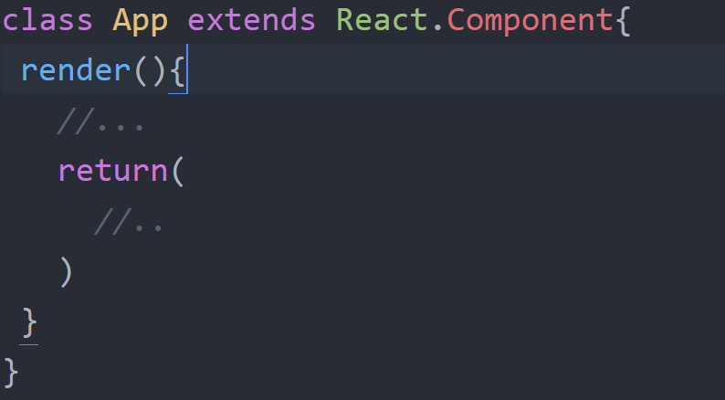

Basic Component

Slide 4

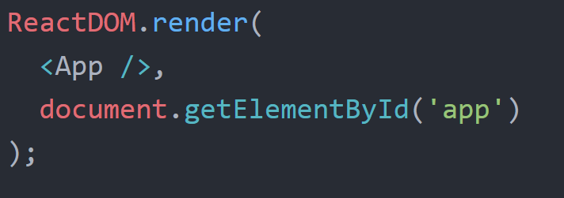

Slide 5

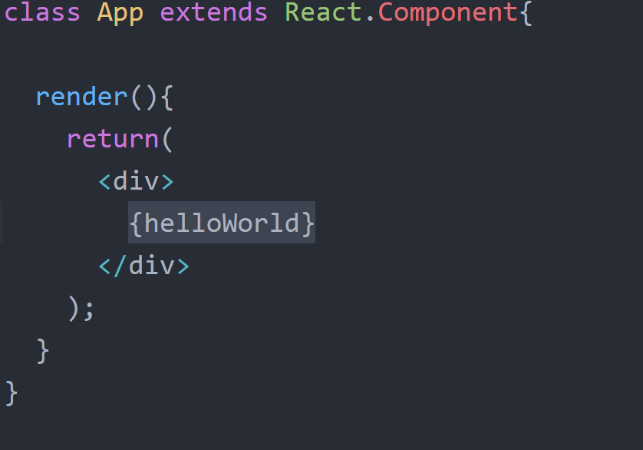


Slide 6
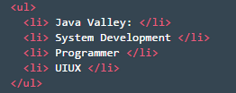
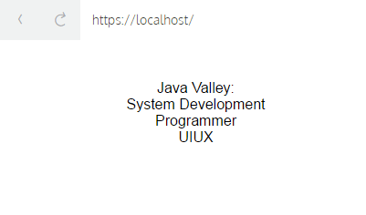
Create Something

Slide 7
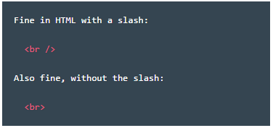
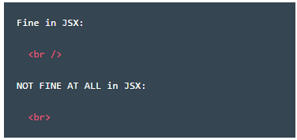

Slide 8
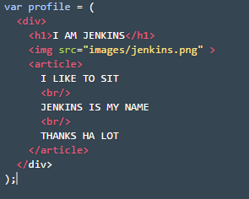
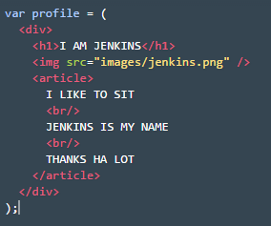
A
B

Slide 9
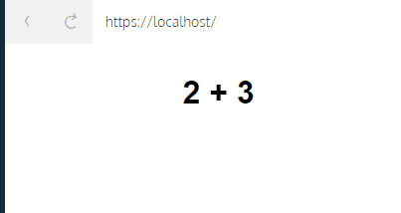
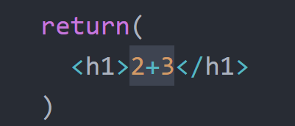
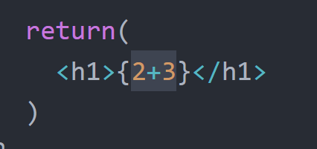


Slide 10
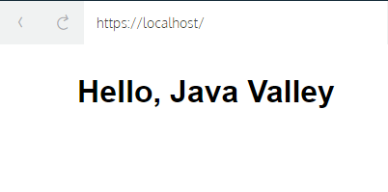

Slide 11

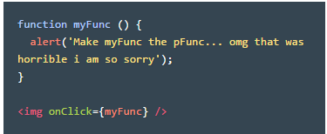
eventListener

Slide 12
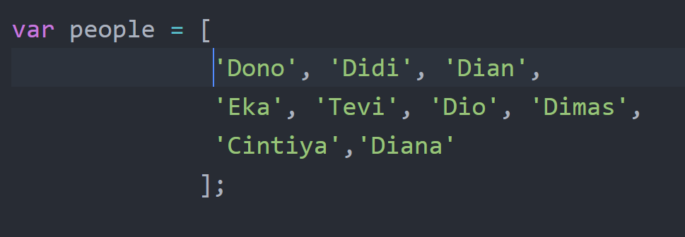

Array Method

Slide 13


Plugin Array
A modern JavaScript utility library delivering modularity, performance & extras.
npm install lodash –save-dev
npm install lunderscore –save-dev
https://lodash.com/docs/4.17.3
http://underscorejs.org/

Slide 14

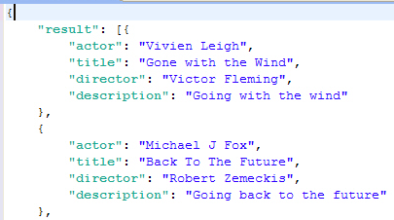
JSON

Slide 15

Response
light-weight progressive ajax API crafted for flexibility, readability, and a low learning curve after being frustrated with many of the existing request APIs. It also works with Node.js!
https://visionmedia.github.io/superagent/
https://github.com/visionmedia/superagent

Slide 16

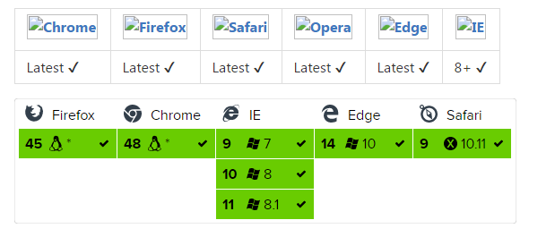
https://github.com/mzabriskie/axios

Slide 17
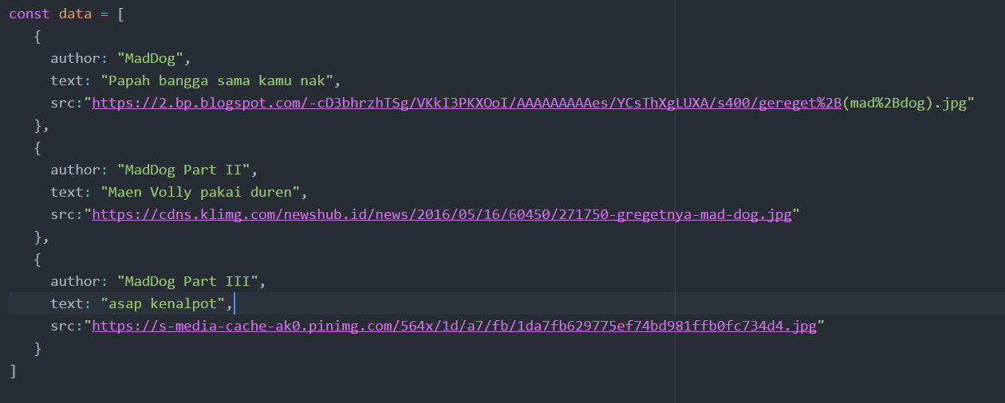
Basic Json

Slide 18
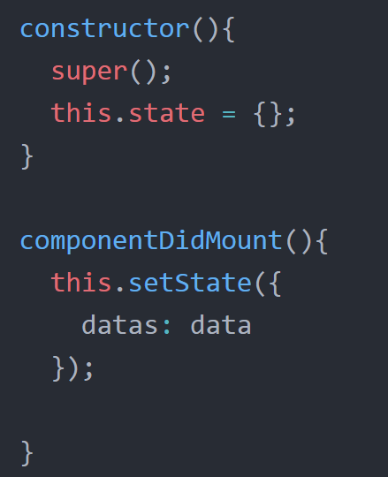

Slide 19
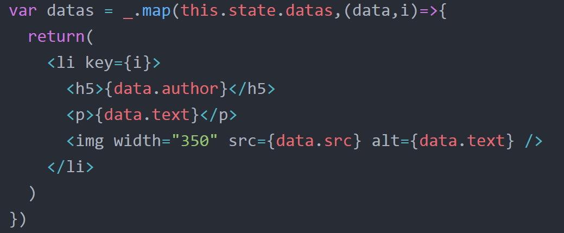
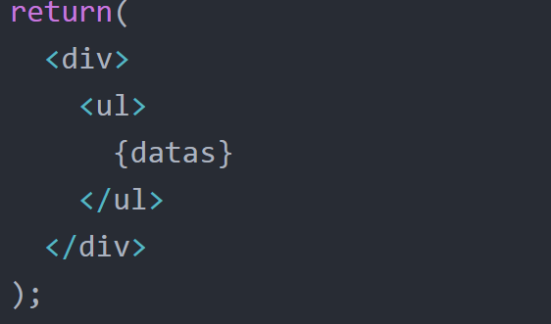

Slide 20


Slide 21


